Slide 1







Slide 2


English Writing I
CQUPT
SCHOOL OF FOREIGN LANGUAGES
英语基础写作1
www.cqupt.edu.cn

Slide 3
English Writing I
CQUPT
SCHOOL OF FOREIGN LANGUAGES
Week 1 - Orientation
www.cqupt.edu.cn

Slide 4




外国语学院
SCHOOL OF FOREIGN LANGUAGES
Content
Course
You
Me

Slide 5


1
Something About Me
毕 燃
1715215636
biran@cqupt.edu.cn
The University of Edinburgh
Subtitle Translator
Language Learner

Slide 6
外国语学院
SCHOOL OF FOREIGN LANGUAGES
2
Something About You
Group Division

Slide 7
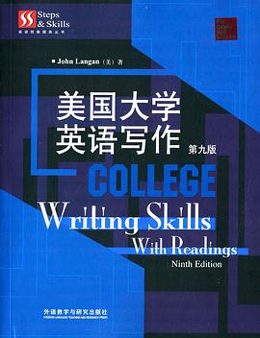
Hours: 8 x 2 Credits: 1 Text: Writing Skills with Readings 美国大学英语写作（第九版） 主编：John Langan 出版社：外语教学与研究出版社
外国语学院
SCHOOL OF FOREIGN LANGUAGES
3
Something About This Course - Syllabus

Slide 8
This Semester: Chapter 1 - Chapter 11
外国语学院
SCHOOL OF FOREIGN LANGUAGES
2
Something About This Course - Syllabus

Slide 9
You need to spend no less than 2 hours per week on this course 90 mins + 30 mins
外国语学院
SCHOOL OF FOREIGN LANGUAGES
2
Something About This Course - Syllabus

Slide 10
外国语学院
SCHOOL OF FOREIGN LANGUAGES
2
Something About This Course - Syllabus
QQ group
腾讯会议

Slide 11
外国语学院
SCHOOL OF FOREIGN LANGUAGES
2
Something About This Course - Syllabus
QQ group
腾讯会议
中国大学MOOC: 英语写作1 （学校云服务-实名制）
https://www.icourse163.org/spoc/course/GYD069-1452609173

Slide 12

外国语学院
SCHOOL OF FOREIGN LANGUAGES
2
Something About This Course - Syllabus
中国大学MOOC: 英语写作1
课堂码：3班 E9MQBW

Slide 13

外国语学院
SCHOOL OF FOREIGN LANGUAGES
2
Something About This Course - Syllabus
中国大学MOOC: 英语写作1
课堂码：4班 E9MEEW

Slide 14

外国语学院
SCHOOL OF FOREIGN LANGUAGES
2
Something About This Course - Syllabus
中国大学MOOC: 英语写作1
课堂码：1班 E95HMW

Slide 15

外国语学院
SCHOOL OF FOREIGN LANGUAGES
2
Something About This Course - Syllabus
中国大学MOOC: 英语写作1
课堂码：2班 E93QKW

Slide 16
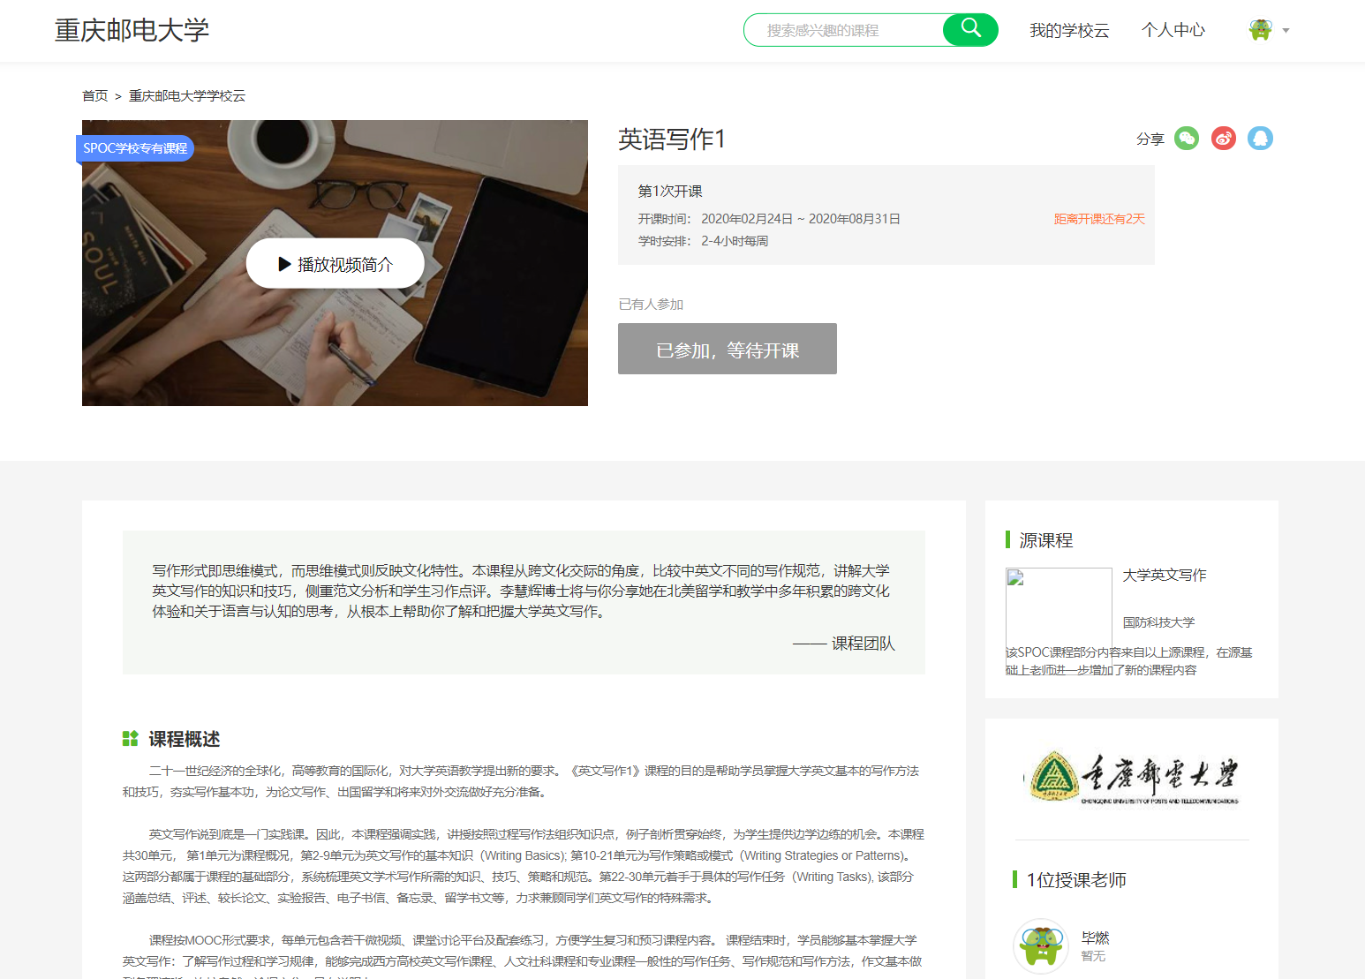
外国语学院
SCHOOL OF FOREIGN LANGUAGES

Slide 17
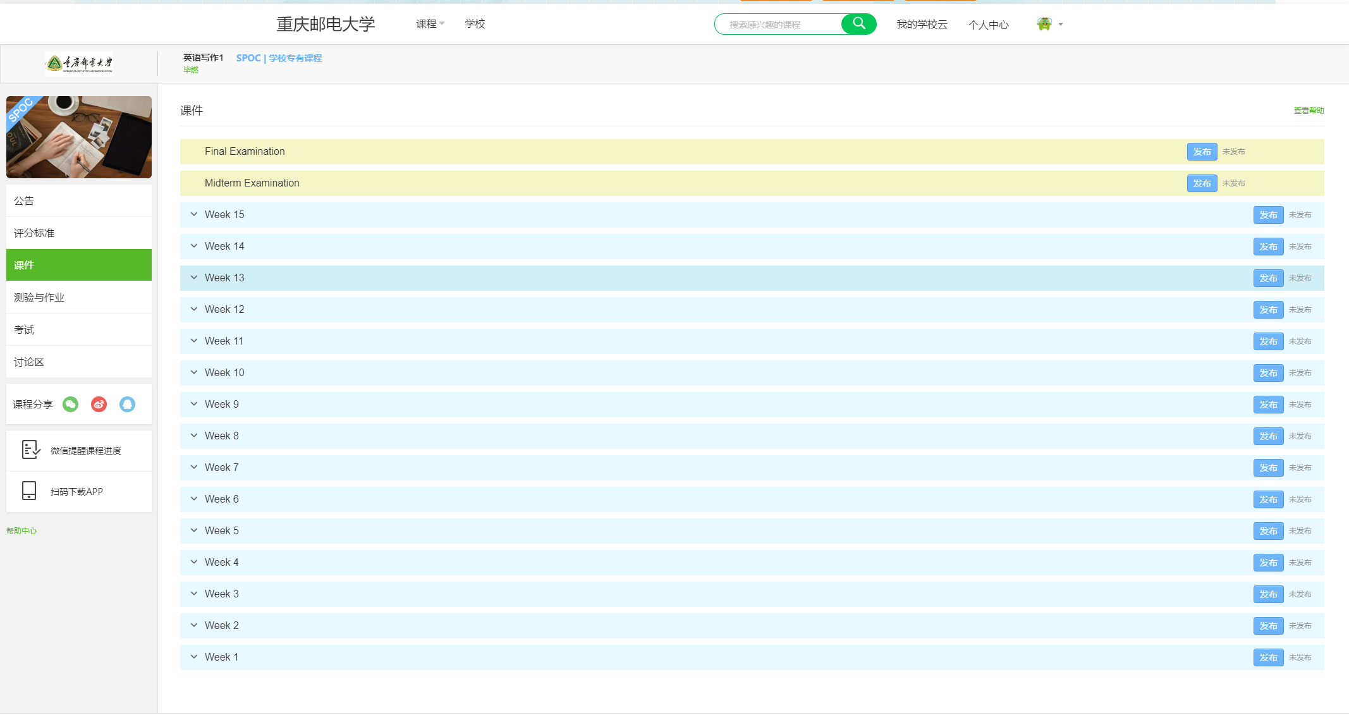
外国语学院
SCHOOL OF FOREIGN LANGUAGES

Slide 18
外国语学院
SCHOOL OF FOREIGN LANGUAGES
2
Something About This Course - Syllabus
QQ group
中国大学MOOC: 英语写作1
批改网：www.pigai.org
班级号：
1班：C3291373
2班：C3291374
3班：C3291375
4班：C3291376

Slide 19
外国语学院
SCHOOL OF FOREIGN LANGUAGES
2
Something About This Course - Final Score Component
小组贡献
课堂表现
平时作业
出勤

Slide 20
Requirement： Deadline is deadline. NO PLAGIARISM ! Be responsible.
外国语学院
SCHOOL OF FOREIGN LANGUAGES
2
Something About This Course

Slide 21

外国语学院
SCHOOL OF FOREIGN LANGUAGES
*
About Plagiarism
Plagiarism

Slide 22
外国语学院
SCHOOL OF FOREIGN LANGUAGES
*
About Plagiarism
Plagiarism
How many types of plagiarism are mentioned in this video?
https://ed.ted.com/lessons/the-punishable-perils-of-plagiarism-melissa-huseman-d-annunzio/review_open#question-7
https://www.bilibili.com/video/av76128408/?spm_id_from=trigger_reload

Slide 23
外国语学院
SCHOOL OF FOREIGN LANGUAGES
1. Renee, the daughter of a U.S. DPI secret agent, procrastinated all semester and started her creative writing project the night before. Renee looked up a random poet online and copied and pasted her poems into her project, claiming them as her own original poems. Renee engaged in the most egregious form of plagiarism, according to the DPI.
A. True
B. False

Slide 24
外国语学院
SCHOOL OF FOREIGN LANGUAGES
2. Lee forgets to write down the details regarding the online sources, interview subjects, and other information she used as she gathered information for her blog about the DPI’S Most Wanted Plagiarists. Running out of time, Lee decides to fabricate the entire works cited section at the end of the blog post. What type of plagiarism did she commit?
A. The Kidnapping Ring
B. One-Sided Collaboration
C. Wild Goose Chase
D. The Old Synonym Switcheroo

Slide 25
外国语学院
SCHOOL OF FOREIGN LANGUAGES
3. In her conspiracy theory project claiming that alien possession is the cause of plagiarism in American high schools, Mary weaves together quote after quote from properly cited outside sources. Has she committed plagiarism?
A. Yes
B. No

Slide 26
外国语学院
SCHOOL OF FOREIGN LANGUAGES
4. Suppose that in the previous example Mary had included no quotes, but she had paraphrased almost every line in the paper and properly cited it. Would this also be considered plagiarism?
A. Yes
B. No

Slide 27
外国语学院
SCHOOL OF FOREIGN LANGUAGES
5. Trudi takes a properly cited paper that she wrote two years ago for an anthropology course, changes the date in the heading, and turns it in for a history course.
A. One-sided Collaboration
B. Variations on a Smokescreen
C. Wholly Quotable
D. She didn’t commit plagiarism since she wrote the original paper!

Slide 28

外国语学院
SCHOOL OF FOREIGN LANGUAGES
*
About Plagiarism
Plagiarism

Slide 29
外国语学院
SCHOOL OF FOREIGN LANGUAGES
3
Something About You
英软19级-3班（31人）
Group | A | B | C
1 | 史澜欣 | 罗超 | 赵智孚
2 | 何超琴 | 周国栋 | 刘君豪
3 | 刘静洁 | 毛尧俊 | 吕泓霖
4 | 李杨 | 周筠淋 | 杨海浪
5 | 王伊娴 | 秦岩杰 | 孔磊
6 | 唐雨婷 | 王贤宇 | 陈柯岚
7 | 孟艳茹 | 凌寨果 | 明洪臣
8 | 梁倩雪 | 陆煜林 | 王建杰
9 | 吴思远 | 赵书立 | 王陈
10 | 申光耀 | 朱子涵 | 罗楷源
 | 陈锦涛

Slide 30
外国语学院
SCHOOL OF FOREIGN LANGUAGES
3
Something About You
英软19级-4班（30人）
Group | A | B | C
1 | 杨艳妮 | 卢京平 | 刘悦航
2 | 李婷婷 | 邓长薪 | 朱国彬
3 | 王泓力 | 谢雨辰 | 王志超
4 | 李媛茜 | 陈汉菻 | 李涛
5 | 李骏迪 | 叶玉峰 | 金瑞祺
6 | 邬翔 | 吴涛 | 朱鹏宇
7 | 蒋绪武 | 曾子玉 | 盛将涞
8 | 张浩洋 | 高宇阳 | 夏德凡
9 | 王波迪 | 谭纶 | 陈明
10 | 祝阳菲 | 唐近 | 龚新黎

Slide 31
外国语学院
SCHOOL OF FOREIGN LANGUAGES
3
Something About You
英软19级-1班（32人）
Group | A | B | C
1 | 刘莹 | 谢宇诚 | 杨宇
2 | 曾诗涵 | 唐逸航 | 李潇
3 | 廖心玥 | 陈浩南 | 谢中林
4 | 陈星余 | 李泽宽 | 陈渝
5 | 杨婷婷 | 邓伟健 | 曹津恺
6 | 邱静怡 | 赵泽森 | 曾敬之
7 | 姜智怀 | 吴迪 | 吴厚涛
8 | 赵凌博 | 罗元章 | 杨小飞
9 | 甘炯文 | 刘星麟 | 陶实
10 | 田鸿 | 陈骄洋 | 黄思亮
11 | 李洋 | 刘浩楠

Slide 32
外国语学院
SCHOOL OF FOREIGN LANGUAGES
3
Something About You
英软19级-2班（31人）
Group | A | B | C
1 | 谢鑫 | 何阳 | 潘重瑜
2 | 赵蕾蕾 | 梁晨诞 | 吕卓林
3 | 傅益佳 | 温朋坤 | 王伟
4 | 刘娜 | 黄伟哲 | 汪礼潇
5 | 倪世慧 | 魏国智 | 叶睿康
6 | 杨悦 | 张鹏展 | 李东明
7 | 涂嘉玥 | 晏正逢 | 陈章
8 | 金洺如 | 何耀 | 向浩源
9 | 柳永华 | 徐强 | 赵中圣
10 | 江浩嵩 | 左敬源 | 陈俊瀚
 | 杨云松

Slide 33
外国语学院
SCHOOL OF FOREIGN LANGUAGES
4
To Do List
Be familiar with APP/WEB:
Download/Favorite
Register
Join the class/group
Self-study
Textbook: Part 1, Chapter 1-2
Watch the video/lecture on MOOC - Week 1
Finish the practice
Quiz & Homework:
11:40 Come back to the QQ /Tencent Meeting

Slide 34
外国语学院
SCHOOL OF FOREIGN LANGUAGES
5
Homework
完成中国大学MOOC 上面Week 1 后面的练习。
DDL:2020/3/1 (Sunday)12:00 noon.

Slide 35
CQUPT
SCHOOL OF FOREIGN LANGUAGES
Thank you！
www.cqupt.edu.cn

